Slide 1
AWS Networking
Route 53
VPC (Virtual Private Cloud)

Slide 2
Route 53
What is Route 53 and how it works?
Route 53 sends automated requests over the internet to a resource, such as a web server, to verify that it's reachable, available, and functional. You also can choose to receive notifications when a resource becomes unavailable and choose to route internet traffic away from unhealthy resources.
Main functions of Route 53:-
We can use Route 53 to perform three main functions in any combination:
Domain registration,
DNS (Domain Name System) routing, and
Health checking.

Slide 3
Domain registration
To create a website, needs to register the domain name.
Few registrars are available if you want to register/purchase a domain.
If you already registered a domain name with another register, you have the option to register the domain registration to Amazon Route 53.
Amazon Route 53 also supports domain registration for a wide verity of generic TLDs (for e.g. .com & .org) and geographic TLDs (e.g., .be & .us)

Slide 4
DNS (Domain Name System) routing
The process of DNS routing involves converting a hostname (such as www.example.com) into a computer-friendly IP address (such as 192.168.1.1).
An IP address is given to each device on the Internet, and that address is necessary to find the appropriate Internet device - like a street address is used to find a particular home.
There are 4 DNS servers involved in loading a webpage
DNS recursor
Root nameserver
TLD nameserver
Authoritative nameserver
To know more details about DNS: https://www.cloudflare.com/en-in/learning/dns/what-is-dns/

Slide 5
HEALTH CHECKING
Amazon Route 53 health checks monitor the health and performance of your web applications, web servers, and other resources.
Each health check that you create can monitor one of the following: The health of a specified resource, such as a web server. The status of other health checks.
Types of Amazon Route 53 health checks:
Health checks that monitor an endpoint
calculated health checks
CloudWatch alarms
Amazon Route 53 Application Recovery Controller

Slide 6
VPC (Virtual Private Cloud)
What is VPC and how it is used for?
A virtual private cloud (VPC) is a secure, isolated private cloud hosted within a public cloud. VPC customers can run code, store data, host websites, and do anything else they could do in an ordinary private cloud, but the private cloud is hosted remotely by a public cloud provider.
VPC consist of following components:
VPC CIDR Block.
Subnet.
Gateways.
Route Table.
Network Access Control Lists (ACLs)
Security Group.

Slide 7
Below are the optional components of VPC:
IGWs
NATs

Slide 8
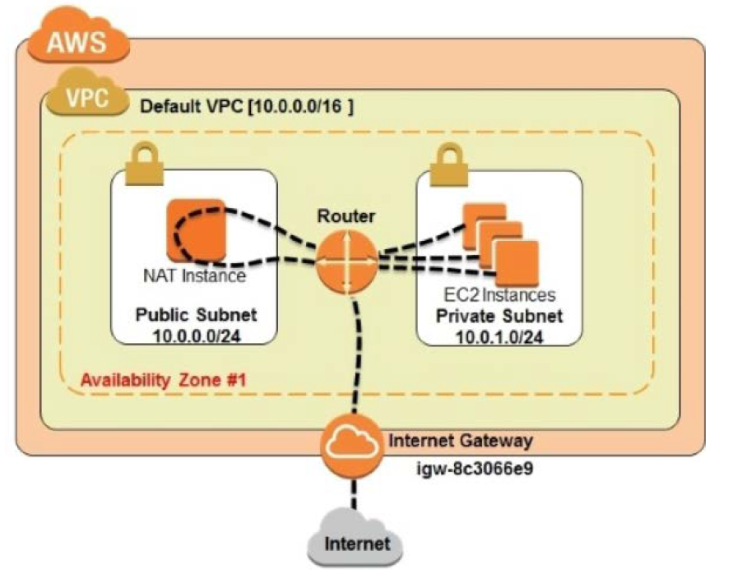
IGW

Slide 9
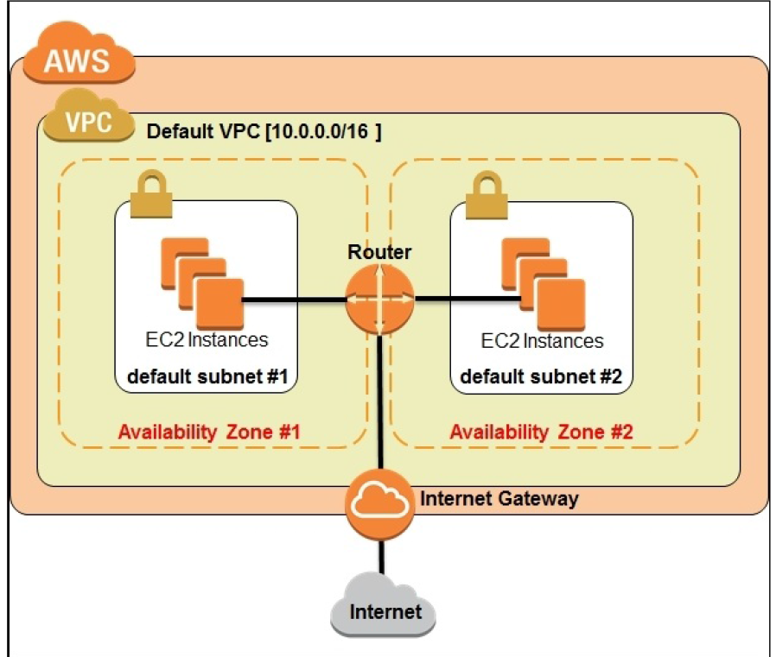
Architecture of VPC

Slide 10
Thank you ☺
- Prasanth Kesamreddy

